Slide 1

Media Bazaar software app project
Pavel Angelov,
Mihai Bălan,
Ivan Bakalov,
Dimitar Atanasov

Slide 2
introduction
Media Bazaar is opening a store in Eindhoven and needs administrative software to manage the store efficiently. Our client, Sachin Bhardwaj, has tasked us with the creation of this solution.

Slide 3
01.
Our solution

Slide 4
What were the issues before?
Work assignment (using online calendars)
Attendance and other evidence (using excel worksheets)
Inefficient methods of work distribution across departments
Little to no internet presence

Slide 5
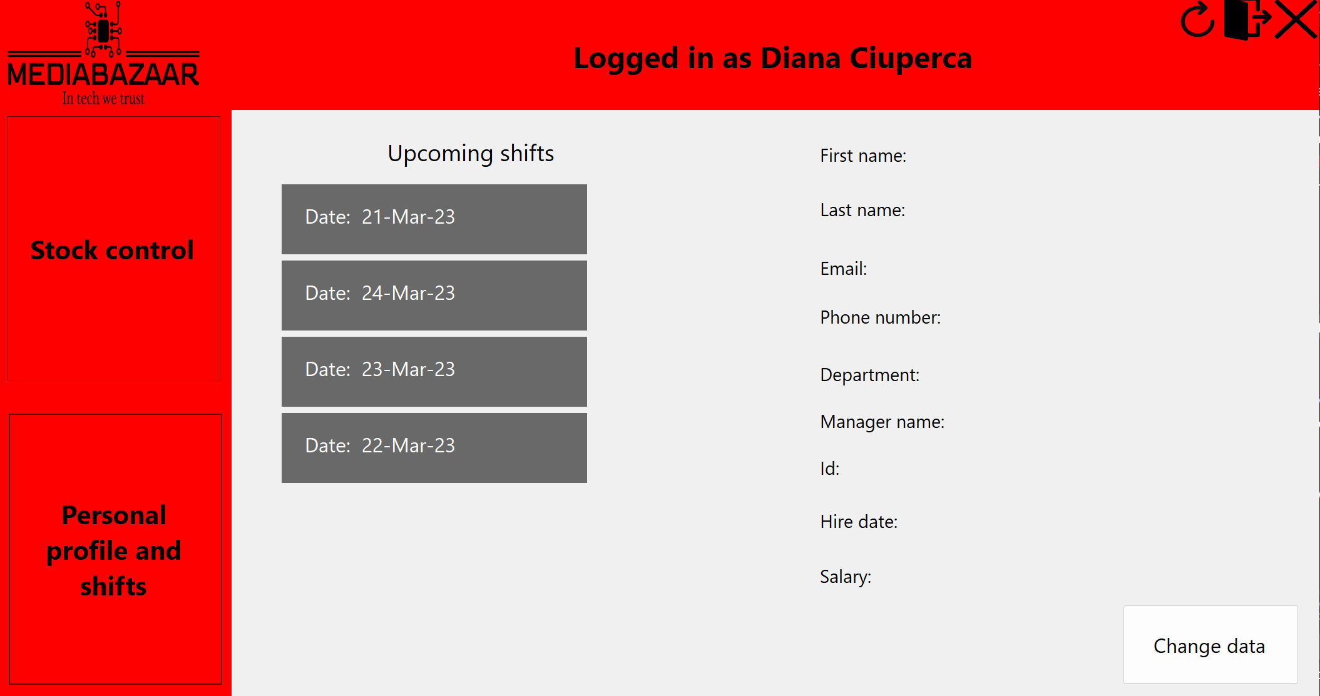
How are we addressing them?
We have employee schedules!

Slide 6
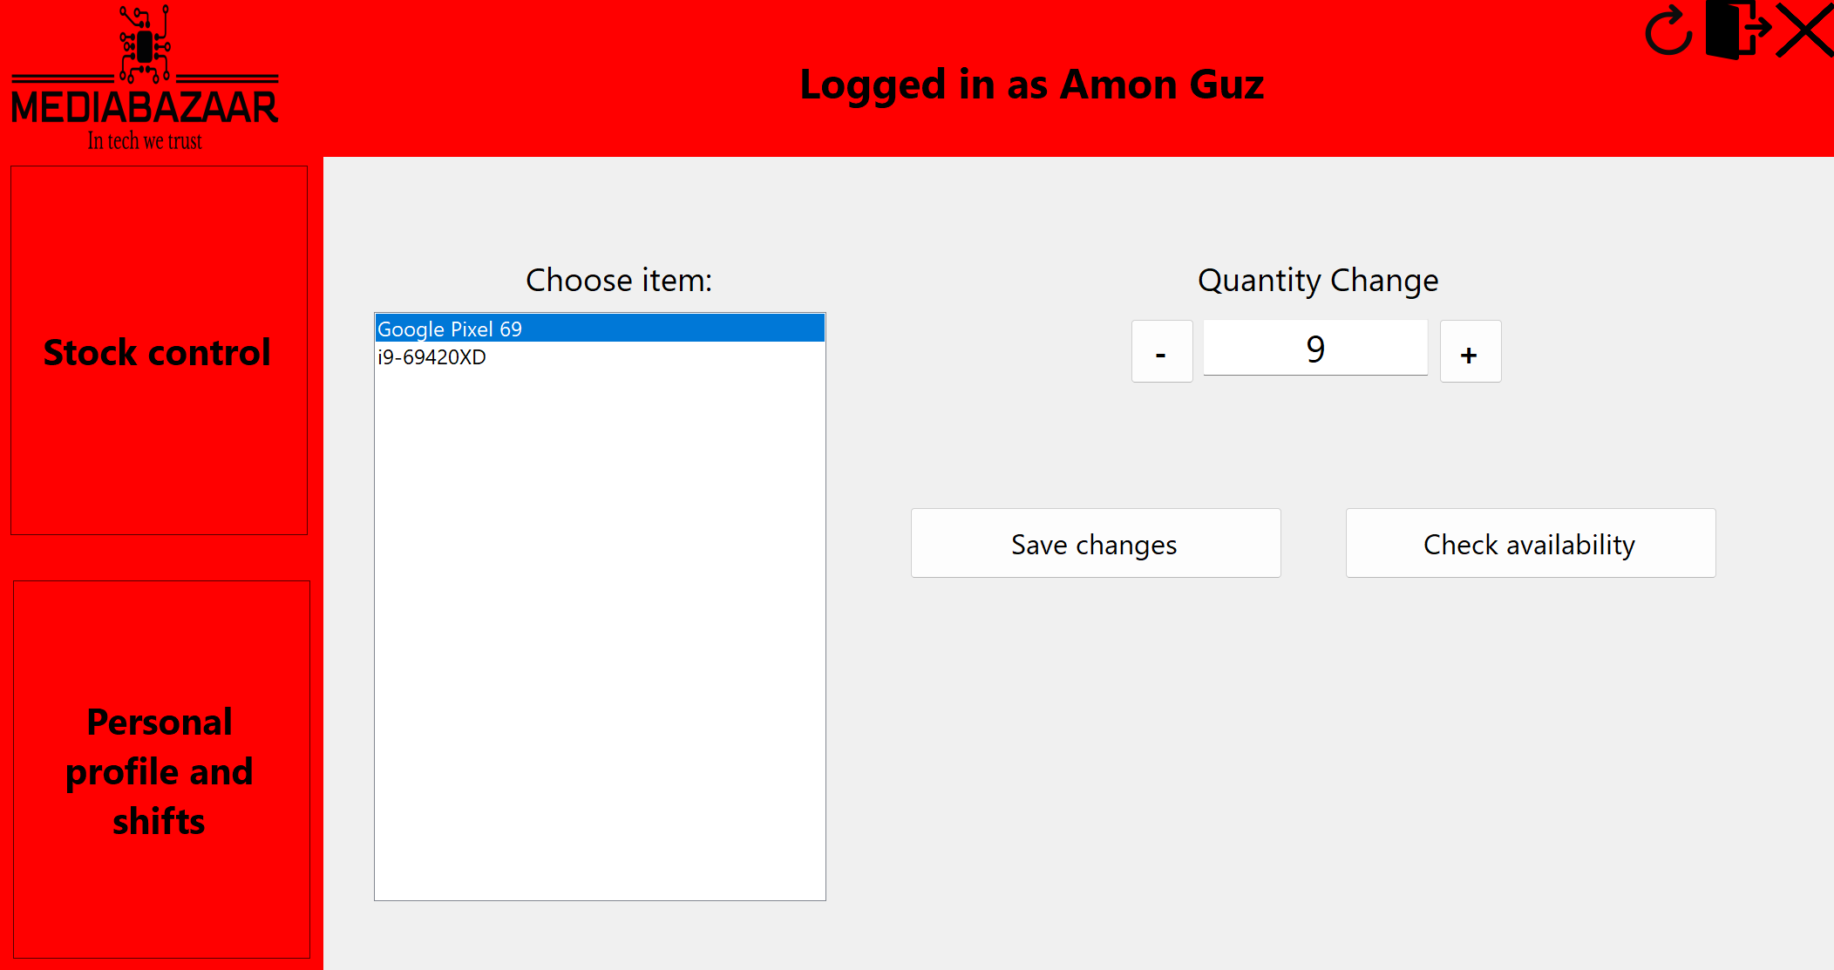
How are we addressing them?
We have a stock managing system to be used by employees!

Slide 7
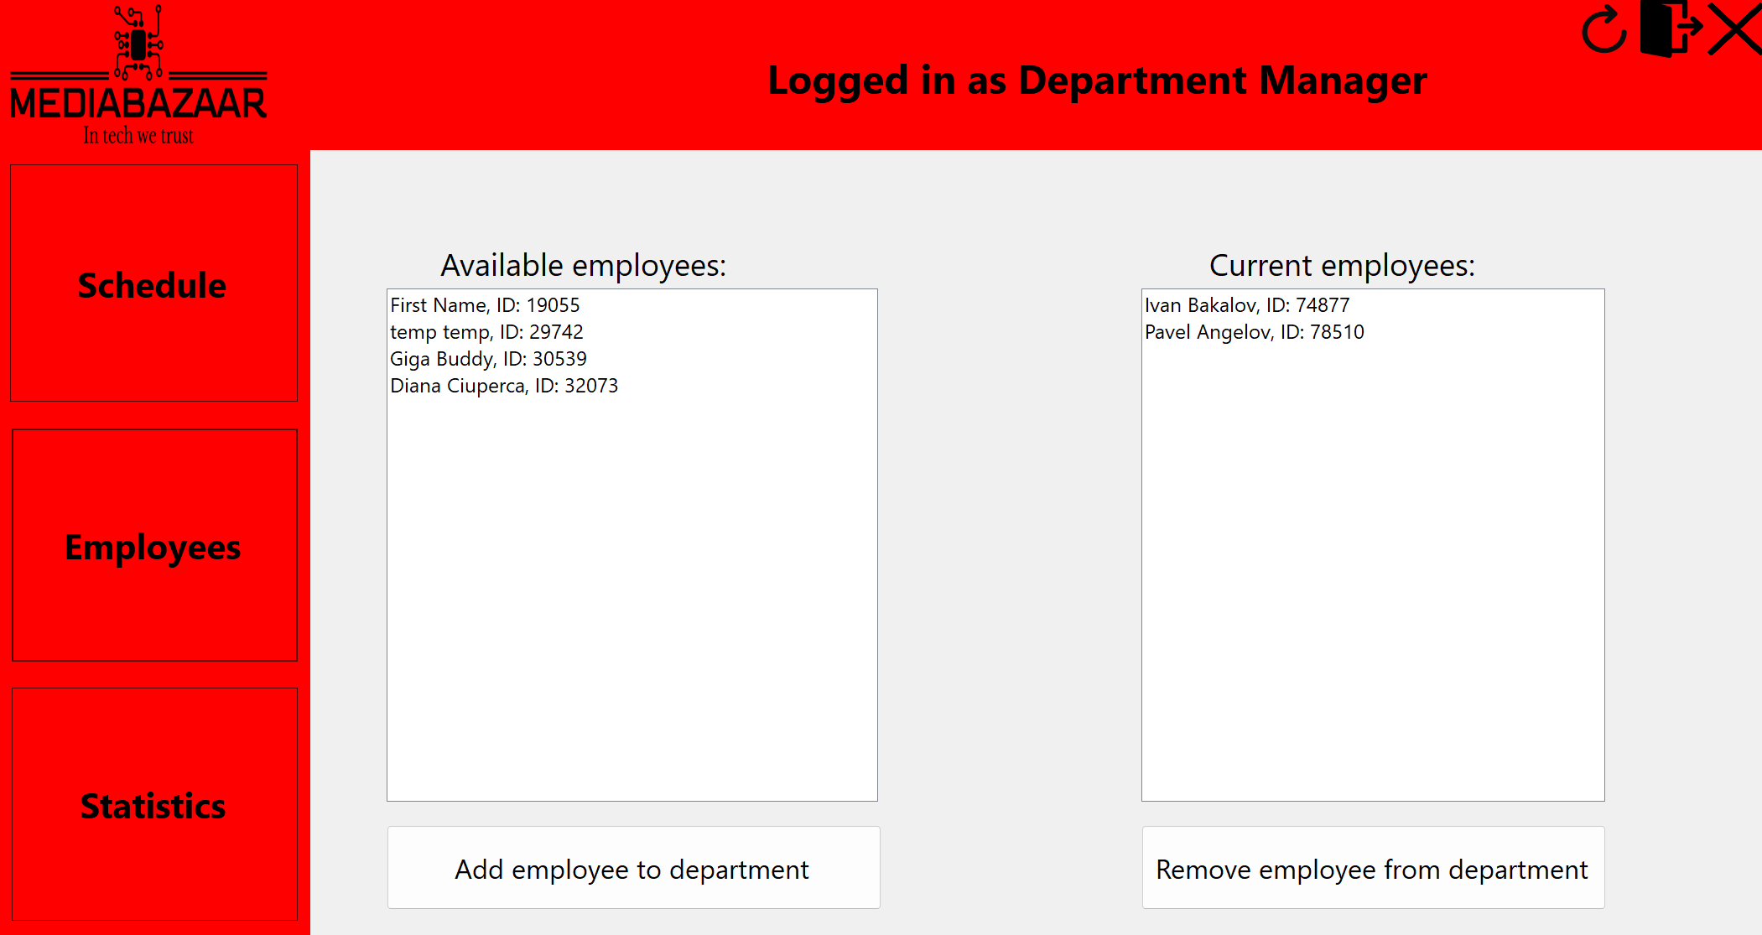
How are we addressing them?
Department Managers can assign employees to their department

Slide 8
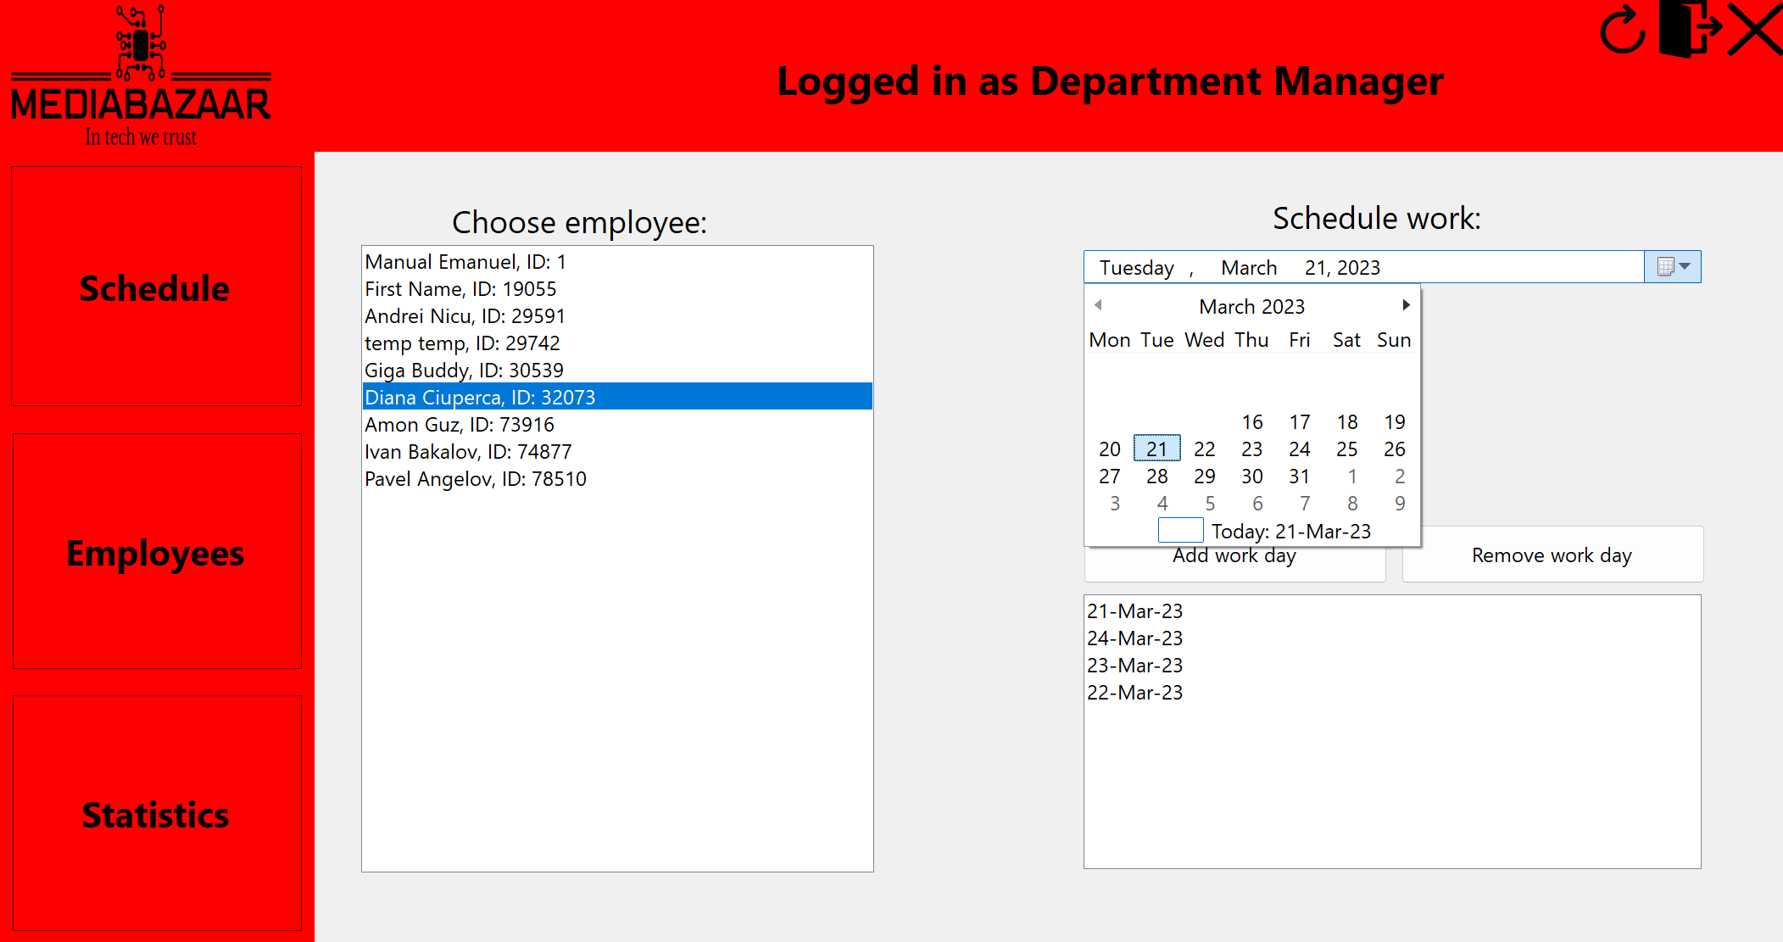
How are we addressing them?
Department Managers can create schedules!

Slide 9
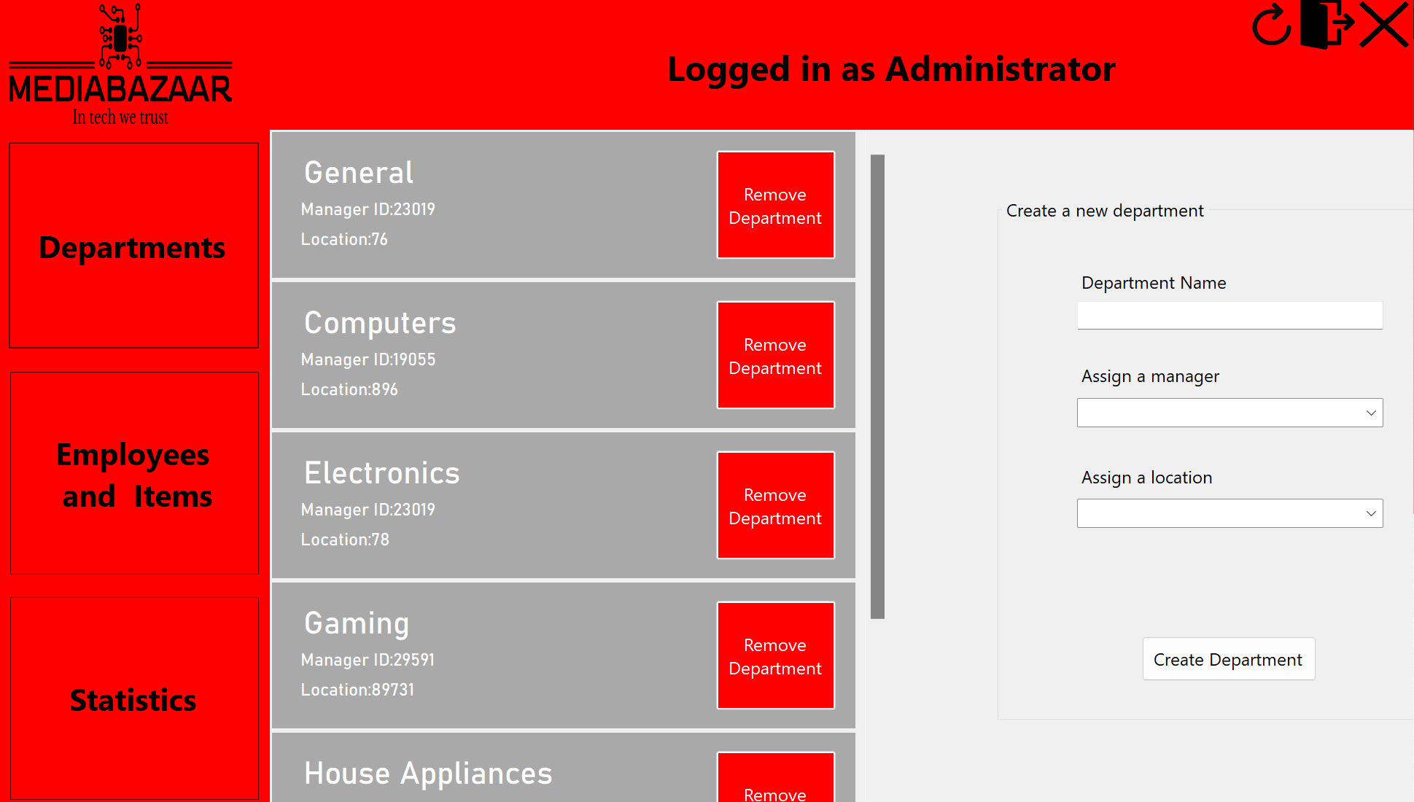
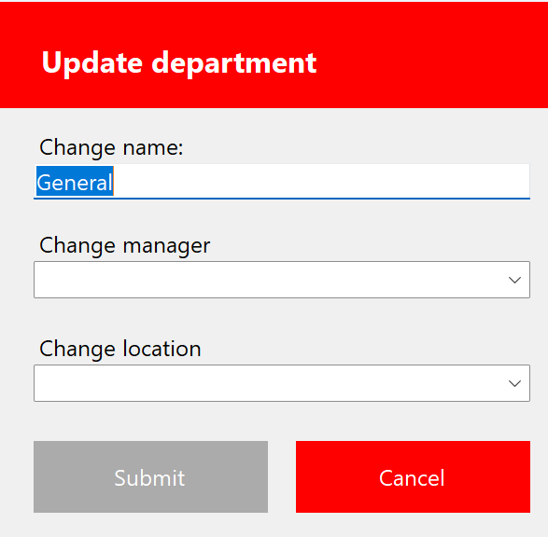
How are we addressing them?
Admins have full control of departments!

Slide 10
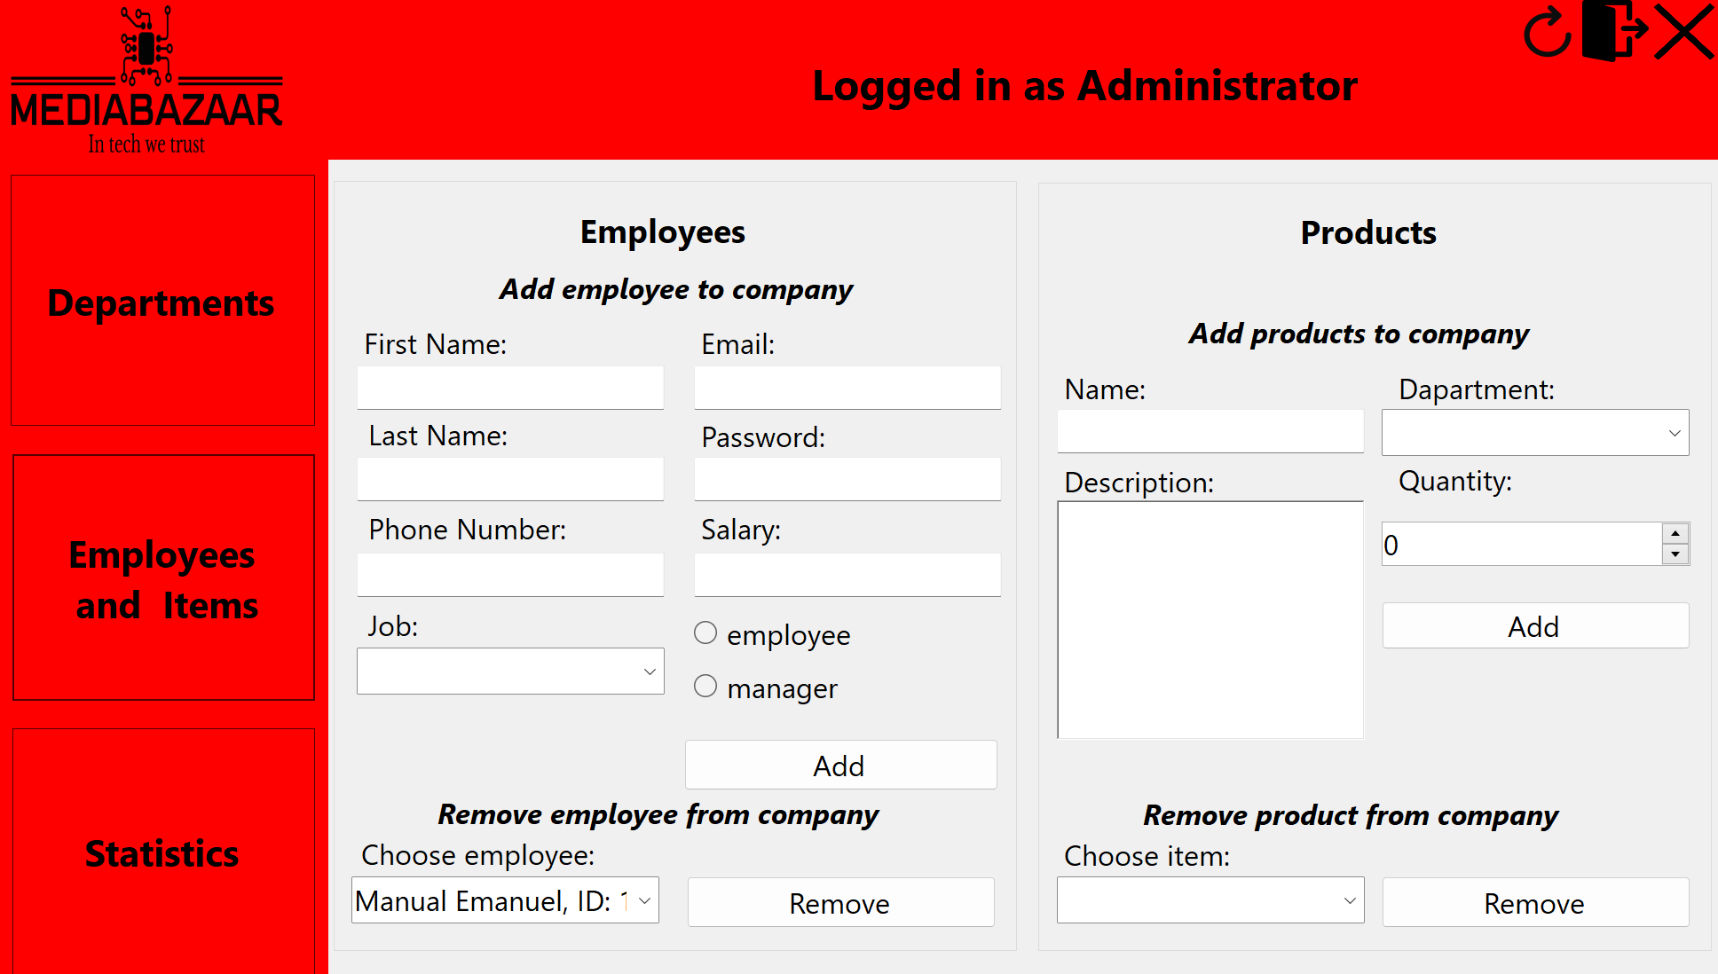
How are we addressing them?
Admins can add new employees!

Slide 11
02.
Our reflections

Slide 12
03.
Your turn!
If you have questions or feedback, now is the time to share!

